Slide 1




EDA OF CAPITAL BIKE SHARE
Enzo Wurtele - Data Analyst for Capital Bike Share
Nov\23\2024

Slide 2
Agenda
01
About the company & my objective
02
Overview of what I have done
03
Data Overview
04
Targets
05
Macro and Micro look at Fleet Usage
06
KPI
07
Machine Learning Model
08
Future Goals

Slide 3


About Capital Bike Share
Capital Bikeshare (CaBi): A bike-sharing service in D.C., VA, and MD, offering eco-friendly, affordable urban transport since 2010
Founded: 2010
Coverage: Washington, D.C., Arlington, Alexandria, Montgomery County, and Fairfax County.
Membership Options: Annual, monthly, or pay-as-you-go.
Mission: Promote eco-friendly, affordable urban transport.

Slide 4
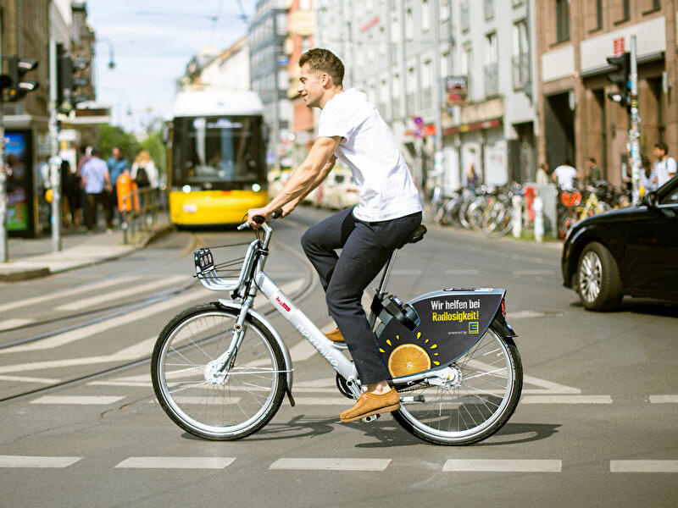
Fleet Optimisation
What is fleet optimisation ?
Maximize fleet efficiency, cut costs, and boost productivity through data-driven management.

Slide 5





Targets of Fleet Optimisation
Target #1
Target #2
Target #3
Maximize Asset Utilization
Optimize bike distribution based on demand patterns.
Use predictive analytics and dynamic rebalancing to reduce idle assets.
Minimize Operational Costs
Apply predictive maintenance to prevent breakdowns.
Optimize rebalancing routes to cut fuel and labor expenses.
Enhance User Experience
Ensure bike availability in high-demand areas.
Offer diverse ride options (e.g., electric bikes) where needed

Slide 6





Overview
01
Pfixed missing values, standardized formats, added Ride Duration, Time of Day, and Day of the Week.
Analyzed ride duration trends by time and user type, highlighting member vs. casual rider patterns.
02
03
Ride duration by day/user type and weekly trends with sorted visuals, clear annotations.
Uncovered rider patterns and usage trends, highlighting operational and marketing opportunities.
04

Slide 7





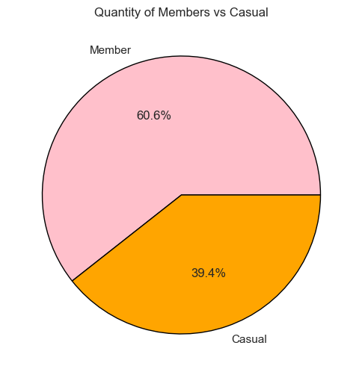
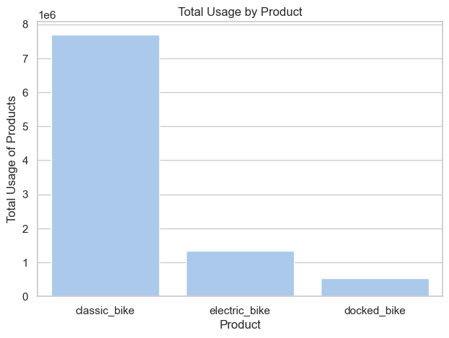
Data Overview
The data shows a clear breakdown of our user base and bike usage patterns.
Members make up the majority of riders, with casual riders forming a smaller, yet significant, segment.
In terms of bike types, we see a mix of classic bikes, electric bikes, and docked bikes, with usage varying across the fleet.

Slide 8


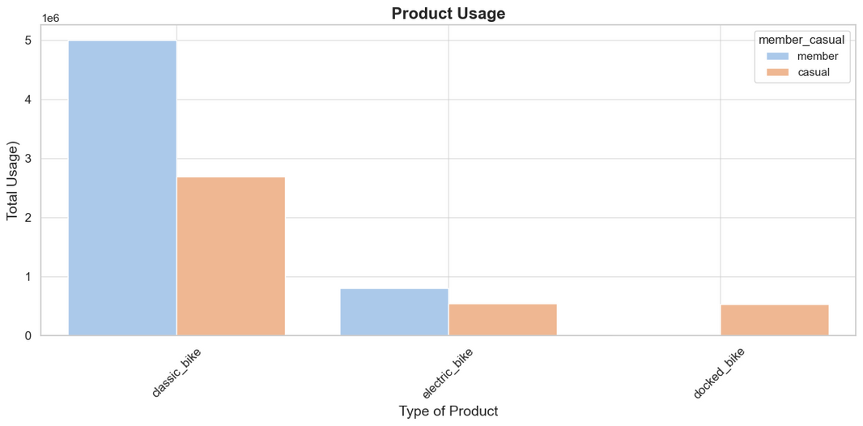
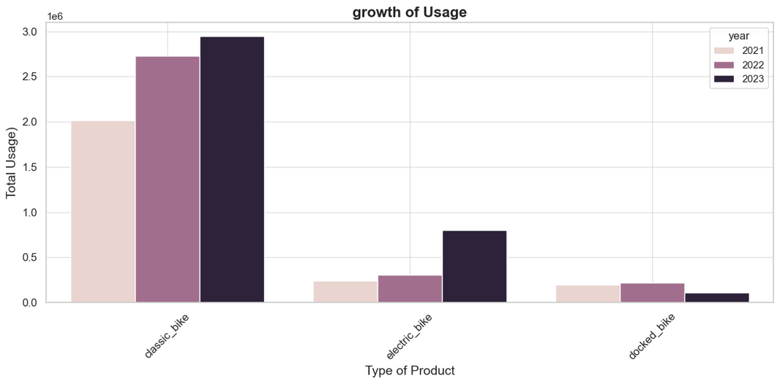
Macro Fleet Usage
Understanding the Distribution
What am needs to be accounted for? What is the current distribution of the capital bike share - bike fleet.

Slide 9
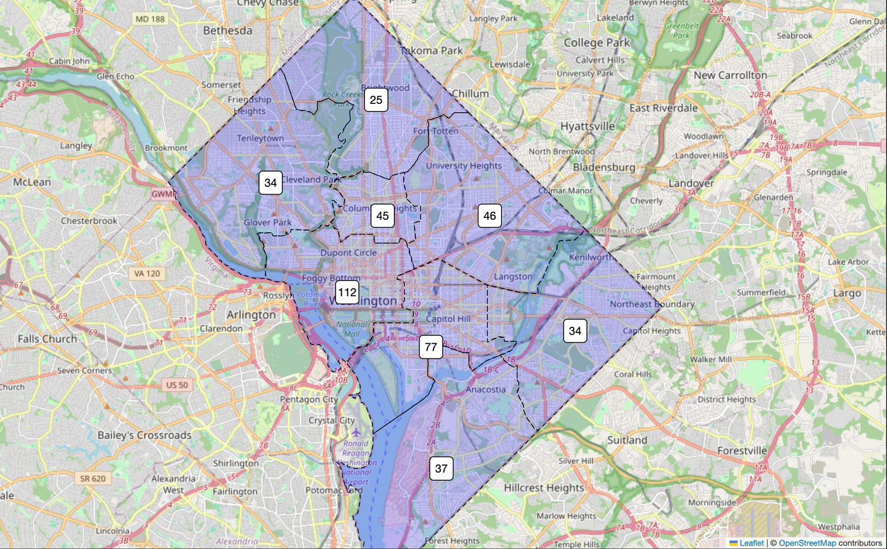
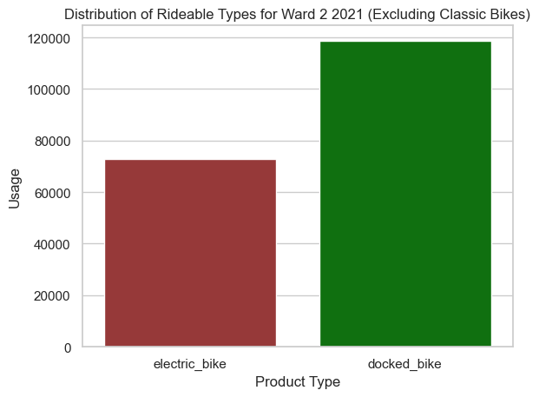
Micro view Fleet Usage
Ward 2
Why did I choose Ward 2? It was chosen for its high usage, high number, its spot is in the middle of the city and number of unique stations.

Slide 10

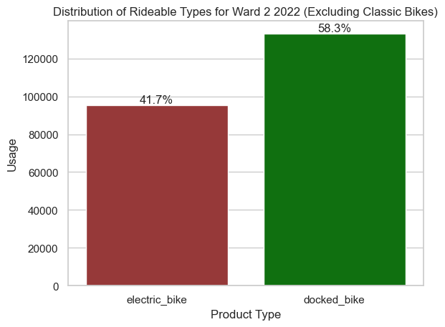
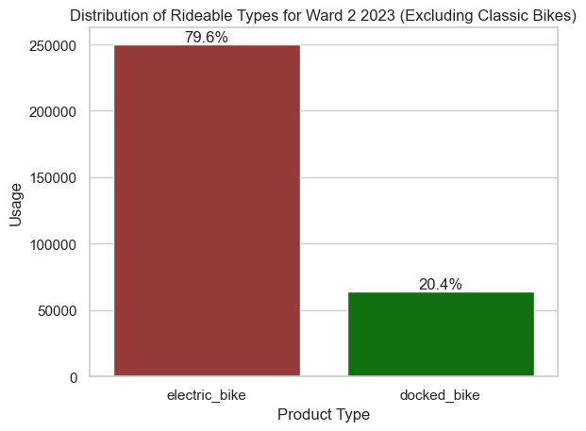
Micro Growth
Electric bikes over three years have had an average decrease of 109.47% and a compounded growth of 44.8%.
Docked bikes over three years have had an average decrease of -67.1% and a compounded growth of −42.63%.
Objective
Evaluating the year-to-year changes in usage.

Slide 11

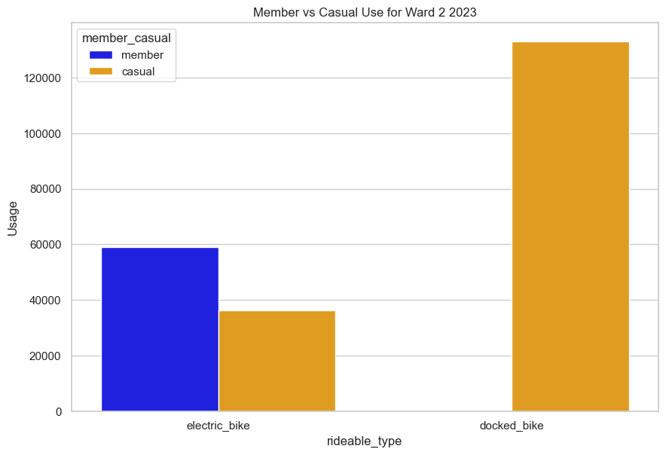
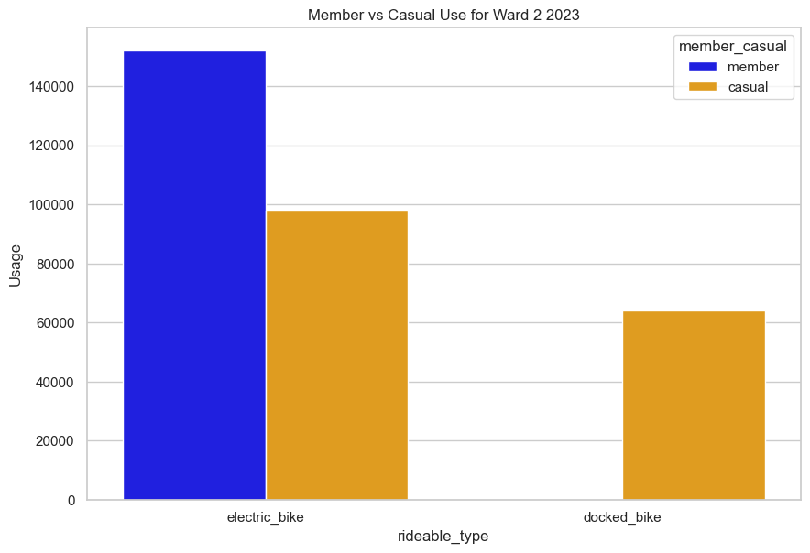
Member vs Casual
Objective
Why was there such a dramatic shift between 2022 and 2024?

Slide 12


KPI / Fleet Optimisation
What is Fleet Optimization?
Strategic management of the bike fleet to maximize availability, efficiency, and customer satisfaction.
Focused on aligning fleet composition with demand trends while minimizing costs.
Why It Matters
KPI Goals
Rising e-bike demand reflects faster, flexible options. Docked bike use declines, highlighting shifting habits and cost-saving opportunities.
Leverage data analytics to align bike supply with demand across all wards.
Next Steps
Expand the electric bike fleet in high-demand areas.
Reposition docked bikes to recreational or low-demand zones.
Track performance monthly to refine the strategy. for a 1 year goal

Slide 13





Analysed Model
Linear Regression
Machine Leaning
Normalised Data
Wrangled Data

Slide 14
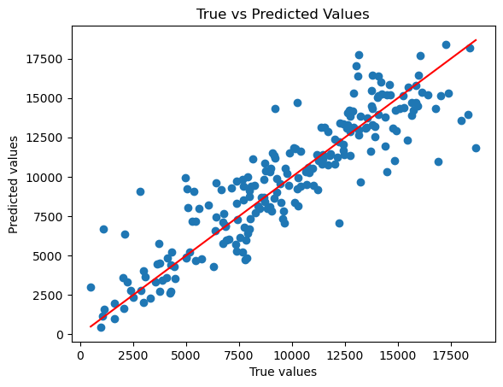
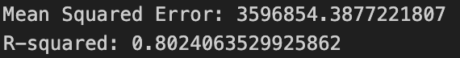
Perfomance of Model

Slide 15

Conclusion
Fleet Optimization is Key: Efficiently managing the bike fleet ensures we meet rider demand while minimizing costs.
Electric Bikes Are the Future: With their growing popularity, they should be prioritized in expansion and maintenance efforts.
Docked Bikes Require Reassessment: Declining usage suggests we need to reconsider their placement and scale.
Member & Casual-Centric Strategy: The high proportion of members highlights the importance of consistent availability and service quality.
Data-Driven Adjustments: Regularly analyzing trends will allow us to stay adaptive and responsive to user needs.

